Slide 1
Server side JavaScript with Node.js
Mohd Ahmed Khan
Arved Baus

Slide 2
Overview
Node.js
Why Node.js?
Our Mini-WebApp
Topics covered in our Presentation
Single Threaded
No CPU intensive operations
Scalable Application
Socket IO
Disadvantages of Node.js
Express.js
Real-Time application
Event Queue
Event Loop
Debugging
Unit Testing
NPM Packet Manager

Slide 3
Node.js
Node.js® is a platform built on Chrome's JavaScript runtime for easily building fast, scalable network applications. Node.js uses an event-driven, non-blocking I/O model that makes it lightweight and efficient, perfect for data-intensive real-time applications that run across distributed devices.
Reference - https://nodejs.org/
Acronyms | Short definition
Chrome’s JavaScript runtime | V8 JavaScript Engine written in C++
Scalable | Huge number of simultaneous connections with high throughput
Event-driven | Event-Loops monitoring events
Non-blocking | Not blocking response until computation is done
Real Time Application | An application that functions in a time frame that user senses as immediate

Slide 4
Why Node.js?
Real Time Applications
2-way connection, in which client or server can initiate communication.
It’s all based on the open web stack (HTML, CSS and JS) running over the standard port 80
Push Capability from server side. So, client doesn’t need to check for new data again and again
On a RAM of 8GB, Node.js can achieve upto a Million concurrent connections compared to 4000 with traditional web-serving techniques.
Differs from Flash and Java Applets as they are sandboxed environments, they run in isolation and use non-standard ports, which may require extra permissions.

Slide 5
Our Mini-WebApp
We are going to develop an online Bet system to demonstrate the core concepts of Node.js
We will also develop a fake openligadb server to show the real time application at the time of presentation
Our server would use 2 types of communication:
REST – To check periodically for availability of new match at fake openligadb server. We will use this to demonstrate REST services and asynchronous callback in Node.js
Sockets – To communicate with the client. Remember, sockets are 2 way connections and communication can be initiated from both sides. In case of new bet, client initiates the communication. In case of new Match or winner, server initiates the communication.
The business logic at the server would not be complex to show “No CPU intensive operations” requirement.

Slide 6
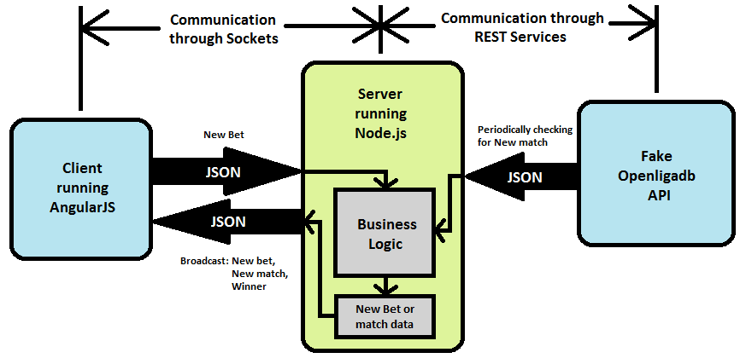
BetYourFriends! - Architecture

Slide 7
Topics covered in our Presentation
Single Threaded
No CPU intensive operations
Scalable Application
Socket IO
Express.js
Real-Time application
Event Loop
Event Queue
Debugging
Unit Testing
NPM Packet Manager

Slide 8
Single Threaded
Traditionally each connection (request) spawns a new thread at server taking up RAM. However, Node.js uses a single thread to manage all connections.
We will use sockets to communicate between client and server. The client would send an event and server would be running a single thread detecting events.
The concept of single thread would become more clear using a pictorial representation on the following slide.

Slide 9
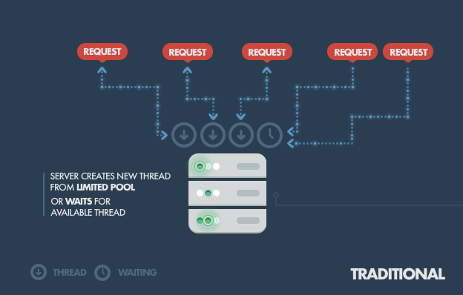
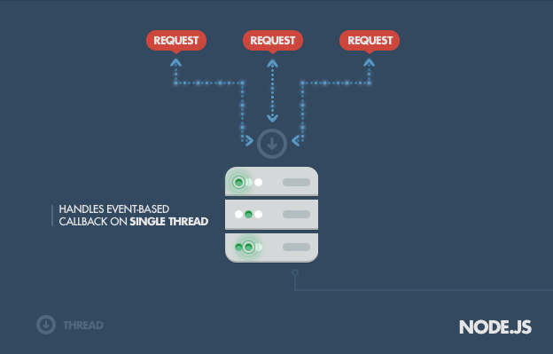
Single Threaded
Reference - http://www.toptal.com/nodejs/why-the-hell-would-i-use-node-js

Slide 10
No CPU intensive operations
Single threaded Node.js also brings a disadvantage to the surface. Since, the application is single threaded it only use one core of the CPU even if there are more cores available. Due to this, we can’t make CPU intensive operations.
In our application our business logic would be simple and wouldn’t use much CPU/memory. Making complex logic would eventually result in blocking IO calls or termination (crash) of the application.

Slide 11
Scalable Application
For example, Consider a system with 8GB of RAM. Traditionally each connection would require a single thread taking upto 2MB of memory. This would result in 4000 concurrent connections plus the cost of context switching between threads.
With Node.js we can acquire up to 1 million concurrent connections due to the fact that all connections are handled through a single thread.
But remember, Node.js was never created to solve the compute scaling problem. It was created to solve the I/O scaling problem. So, the problem that operations can’t be CPU intensive still remains.
Reference - http://www.toptal.com/nodejs/why-the-hell-would-i-use-node-js

Slide 12
Socket IO
Socket.IO enables real-time bidirectional event-based communication. It works on every platform, browser or device, focusing equally on reliability and speed.
Reference - http://socket.io/
We will implement Sockets to communicate between the server and client. As shown in the architecture, communication could be initiated from server or client.
Use-case: Client sends a bet to server provoking an event. The server detects the event, validates the bet and place the bet on a live match.
Use-case: The server detects that the match is over and broadcasts the winner to all clients.
Use-case: The server receives new match data and broadcasts the data to all clients.

Slide 13
Express JS
Express is a minimal and flexible Node.js web application framework that provides a robust set of features for web and mobile applications.
Reference - http://expressjs.com/
We will use Express.js extensively in our WebApp as it makes coding much easier and hide the low level details of the code.
For instance, a simple REST API server in plain Node.js is 5-10x more line of code than using express framework.
Reference - http://stackoverflow.com/questions/12616153/what-is-express-js

Slide 14
Real Time Application
A real-time application (RTA) is an application program that functions within a time frame that the user senses as immediate or current.
Reference - http://searchunifiedcommunications.techtarget.com/definition/real-time-application-RTA
We especially made Fake openligadb server to show this aspect in our app during the time of presentation.
We plan to run a live match at openligadb server and let the audience bet on it in real time.

Slide 15
(Blocking) Input/Output
Blocking IO operations are for example writing to a file or connecting to a database
Traditional blocking programming does IO in the same fashion as regular function calls
If a Thread calls a blocking function, it has to wait until the function returns

Slide 16
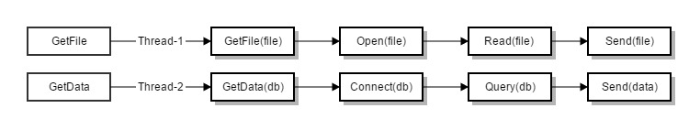
Traditional Threaded Web Model
Incoming Requests are assigned to available Threads
Thread handles request and sends response on complete
➔ Every incoming request generates a new Thread
→ Increasing overhead to manage them

Slide 17
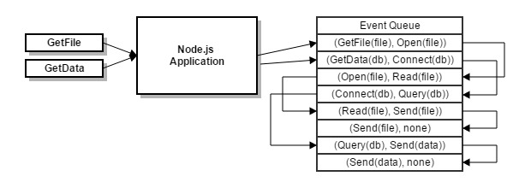
Event Queue
Add Incoming requests to Event Queue
Single Thread runs event Loop to pick up events from Event Queue
NodeJs avoids to wait for blocking I/O
NodeJS has a Built-in Thread pools which handles blocking tasks
Blocking Tasks execute Callback function after finishing
➔ To develop a scalable Application work must be divided into smaller tasks.

Slide 18
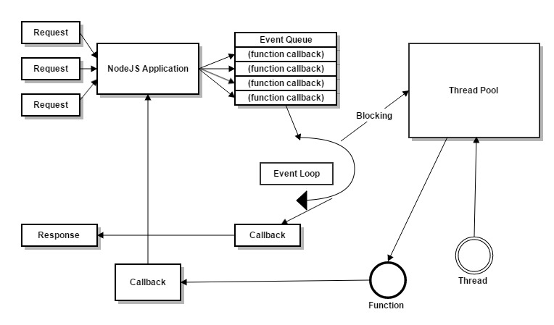
Event Loop
Blocking IO Operations are executed in a separated Thread
Requests and other asynchronous work are placed on the event queue
Non-Blocking functions are directly executed on the event loop
When the blocking callback completes, the thread is released to the thread pool
Callback function will either send a response or schedule another asynchronous tasks on the event queue

Slide 19
Adding Work to the Event Queue
Non Blocking IO Call
Add event listener to built-in or custom events
Using process.nextTick option to schedule work the next event loop
Use timers to schedule work to be done after a particular amount of time or interval

Slide 20
Debugging
Simple way to inspect objects:
Console.log(obj)
NodeJS provides also a built-in debugger to inspect the local scope during execution
debugger;
var b = a + 1;
Node Inspector
Chromes Built-In code inspector
Breakpoints
Profiler
Livecoding
Webstorm Debugger

Slide 21
Unit Testing
Mocha framework
Usage similar to Junit
Support of Assertions
Testing of Callback flow possible

Slide 22
NPM Packet Manager
Standard Node package manager
Bundled with Node
Support of package.json file format to indicate dependencies and meta information
Provides searching for NodeJS modules
To install a package and add its dependency type:
npm install --save package_name
To install all dependencies of a project:
npm install

Slide 23
Disadvantages of NodeJS
No CPU – intensive operations in scalable Applications
Lack of standard library (Javascript has only a small library)
Rough edges of Javascript Programming Language(e.g. prototype System)
Single-Threaded
Lack of maturity
Callback Hell
➔ Most functions are asynchronous by default
➔ This leads to deeply nested anonymous function callbacks

Slide 24
Thank you for your attention!

